Slide 1
Rainfall Analysis
Between 1901 and 2015

Slide 2
OBJECTIVE
The objective of this analysis is to explore rainfall patterns in various subdivisions of India between 1901 and 2015. Using SQL, the analysis focuses on identifying key trends, such as the subdivision with the highest average rainfall in June.

Slide 3
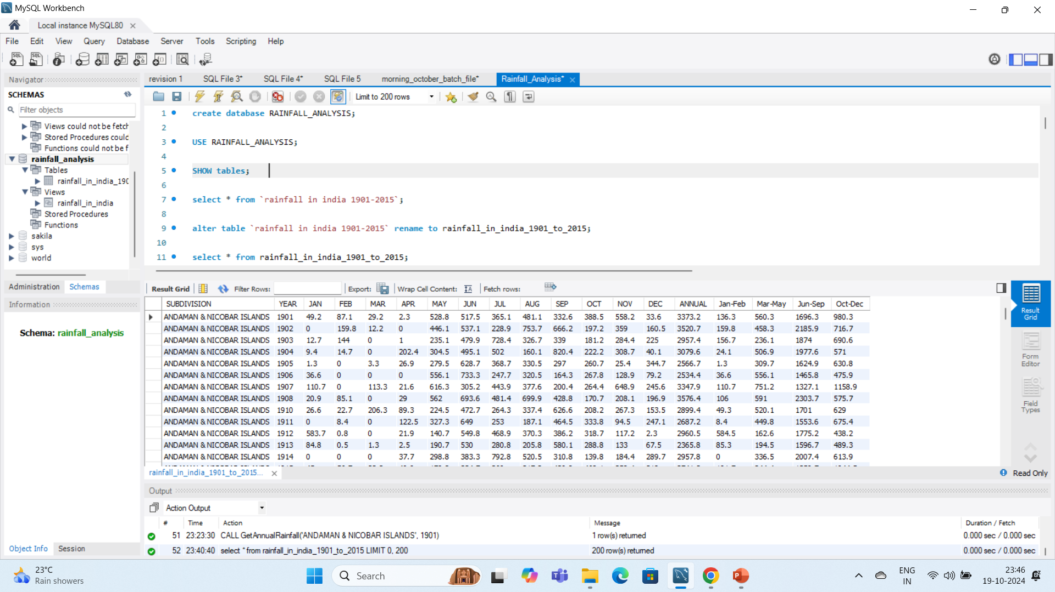
Creating a new database and importing the table and extract all the records in it.
This data contains the raining information of all over the India based on each month and season.
It include the columns subdivision, year, jan, feb, mar, apr, may jun ,jul ,aug, sep, oct, nov, dec, annual,
jan-feb, mar-may, jun-sep and oct-dec

Slide 4
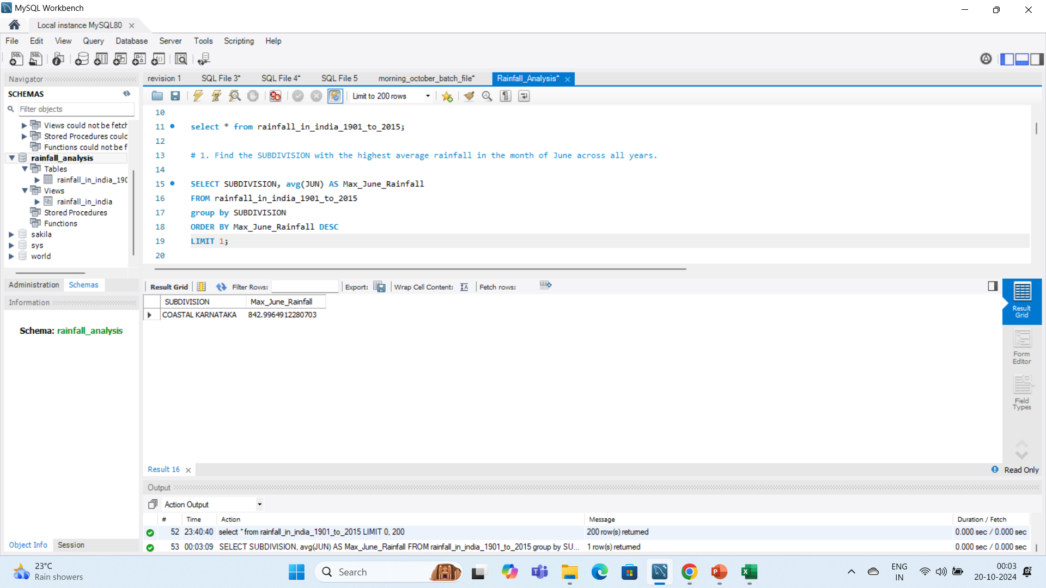
# 1. Find the SUBDIVISION with the highest average rainfall in the month of June across all years.

Slide 5
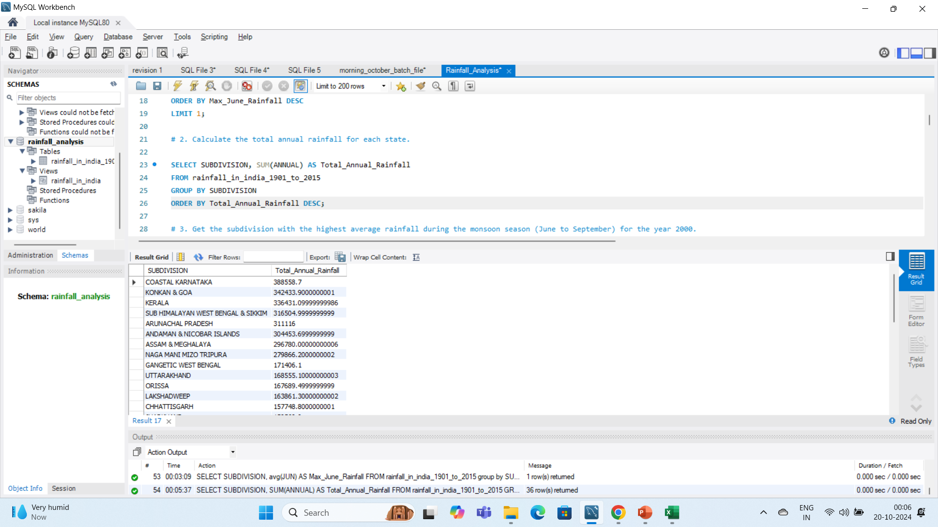
# 2. Calculate the total annual rainfall for each state.

Slide 6
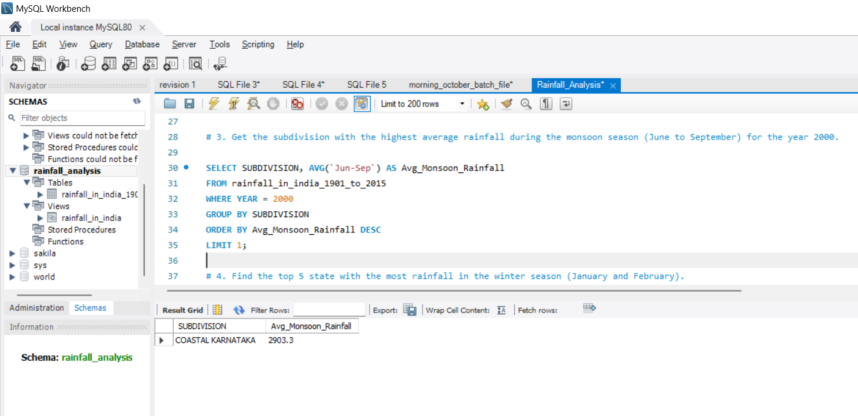
# 3. Get the subdivision with the highest average rainfall during the monsoon season (June to September) for the year 2000.

Slide 7
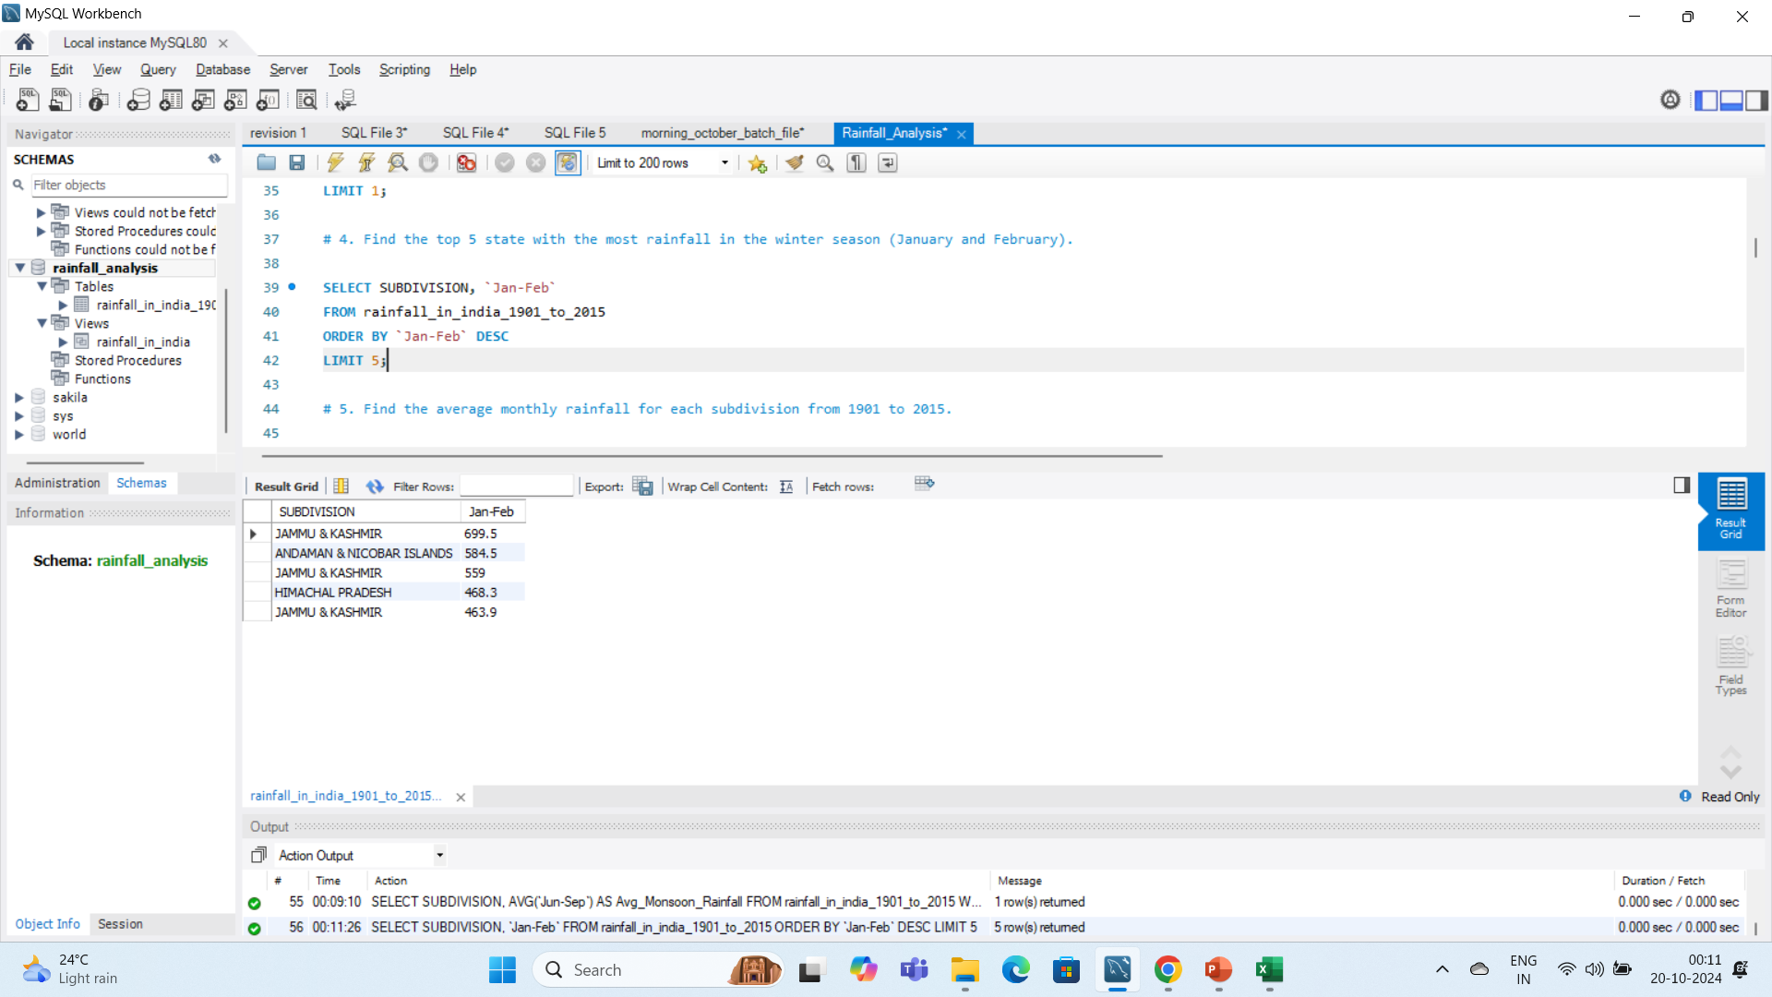
# 4. Find the top 5 state with the most rainfall in the winter season (January and February).

Slide 8
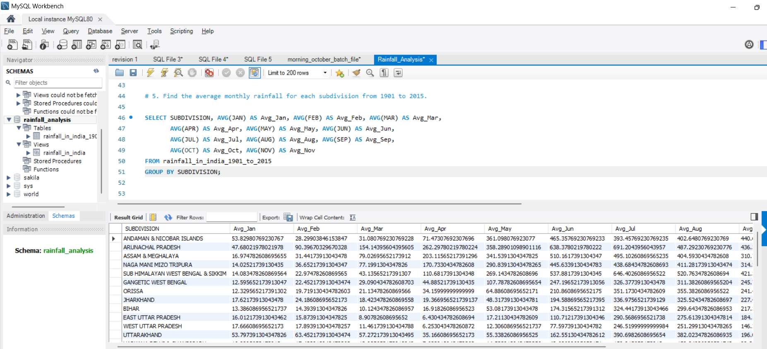
# 5. Find the average monthly rainfall for each subdivision from 1901 to 2015.

Slide 9
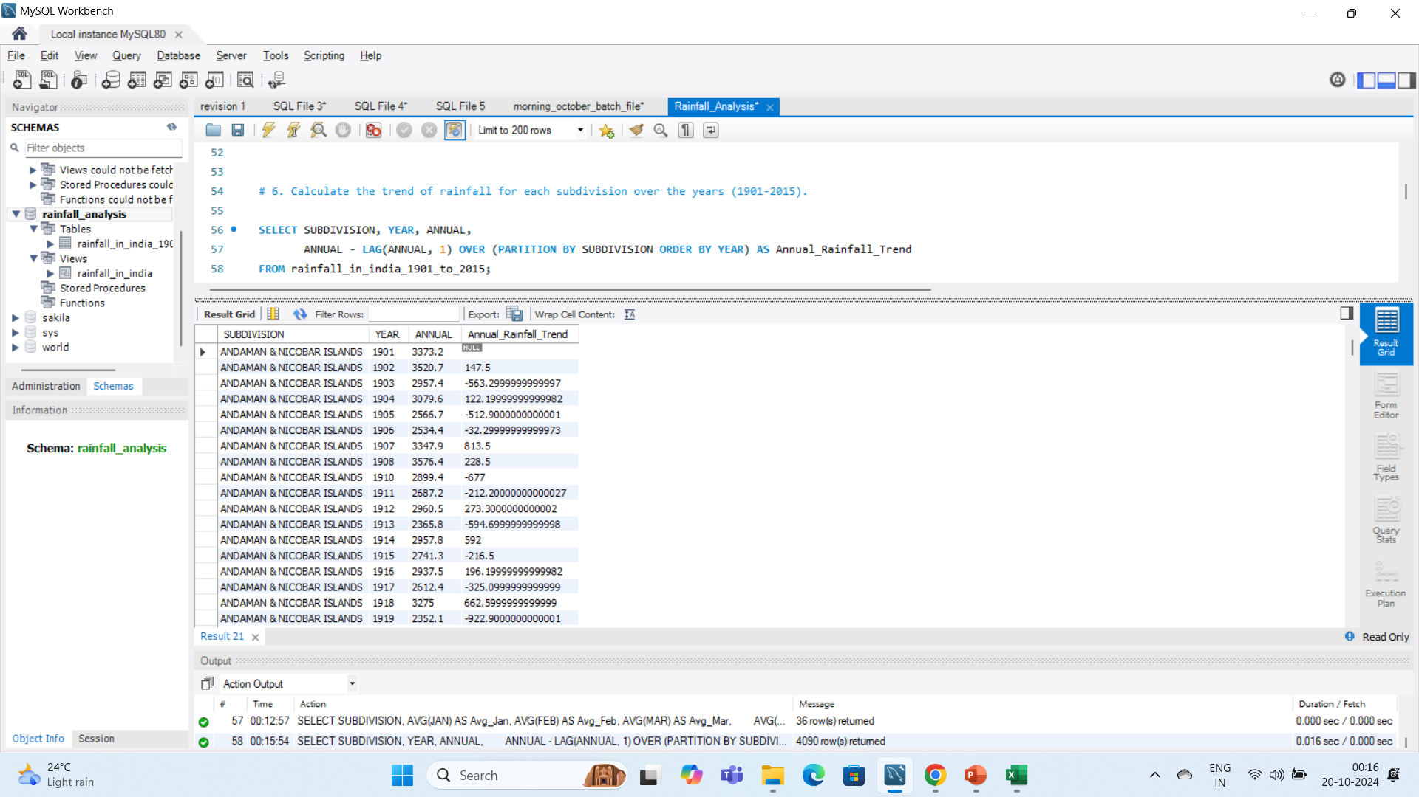
# 6. Calculate the trend of rainfall for each subdivision over the years (1901-2015).

Slide 10
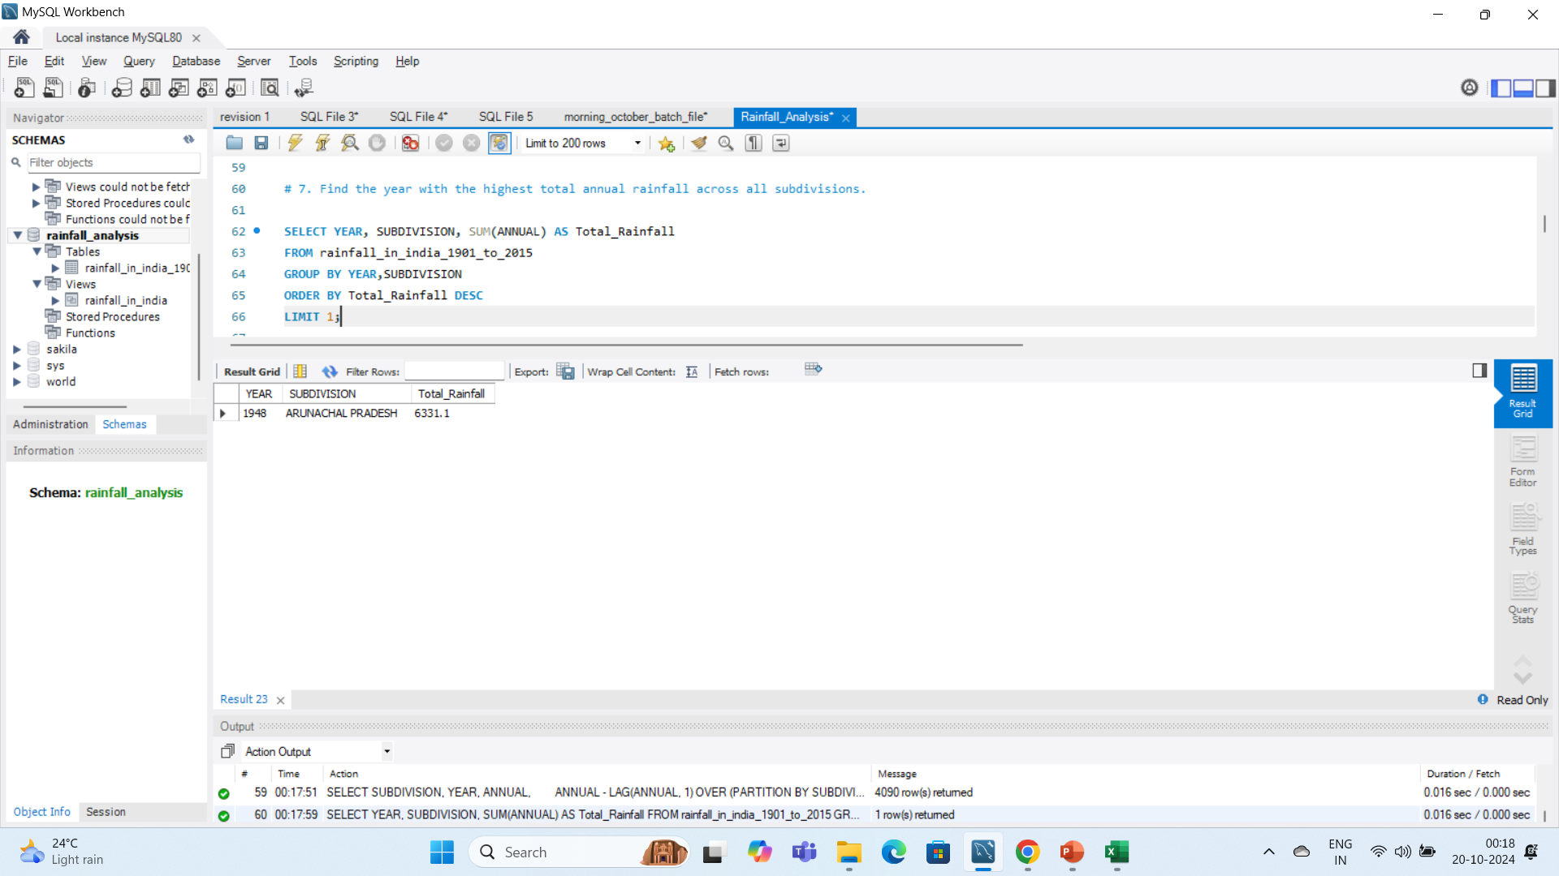
# 7. Find the year with the highest total annual rainfall across all subdivisions.

Slide 11

# 8. Get the subdivision with the lowest average rainfall during the dry season (October to December) across all years.

Slide 12
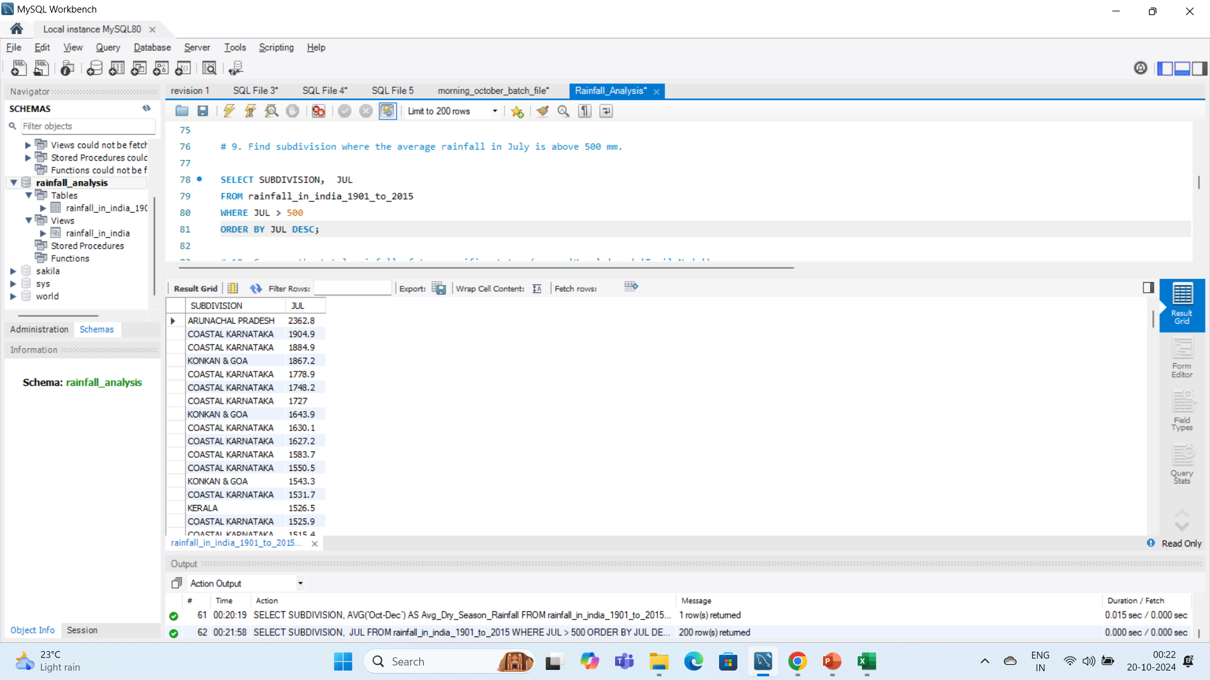
# 9. Find subdivision where the average rainfall in July is above 500 mm.

Slide 13
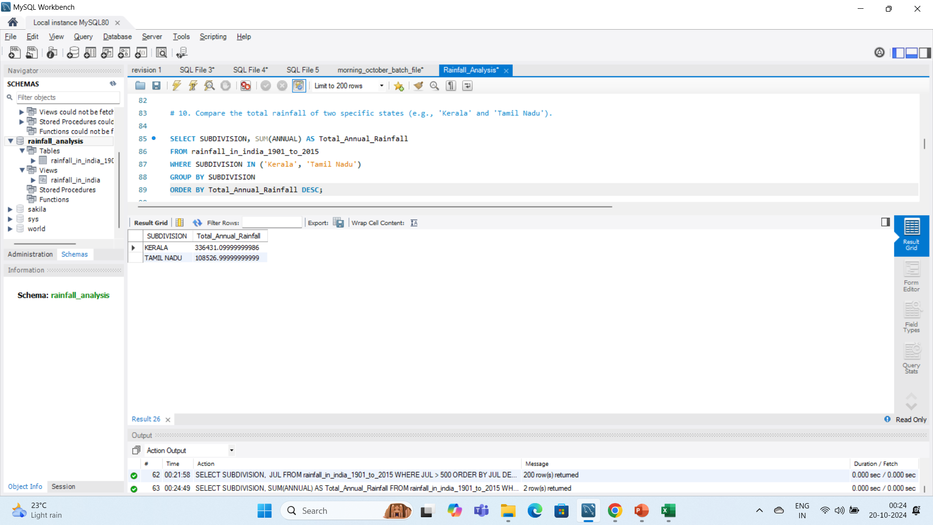
# 10. Compare the total rainfall of two specific states (e.g., 'Kerala' and 'Tamil Nadu').

Slide 14
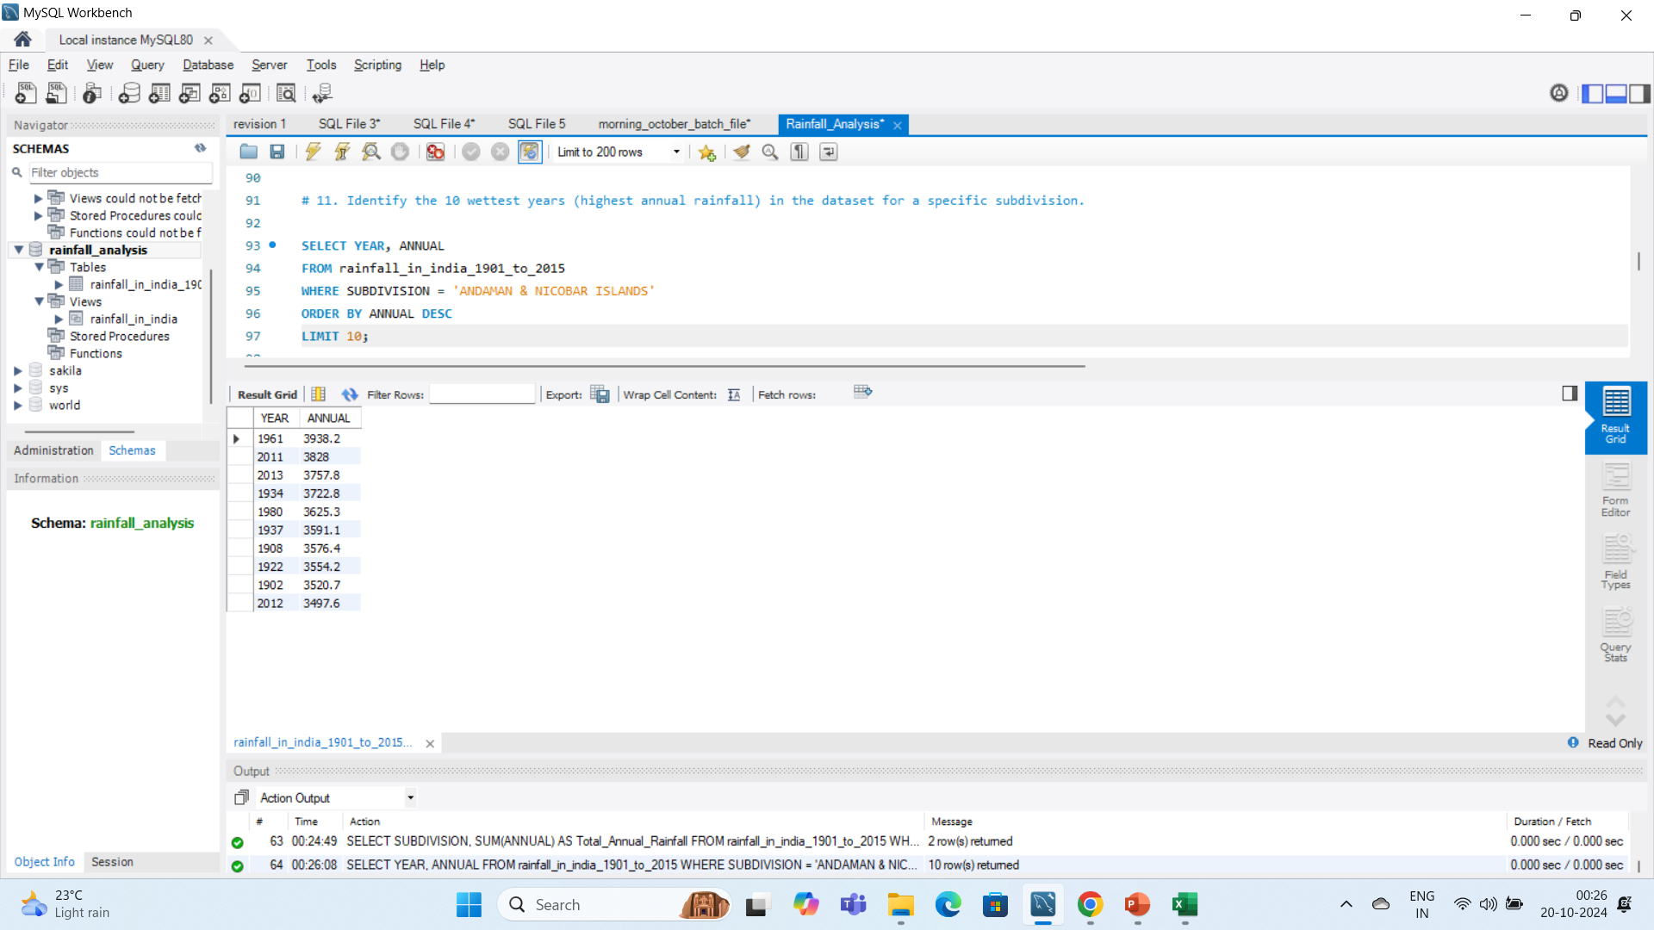
# 11. Identify the 10 wettest years (highest annual rainfall) in the dataset for a specific subdivision.

Slide 15
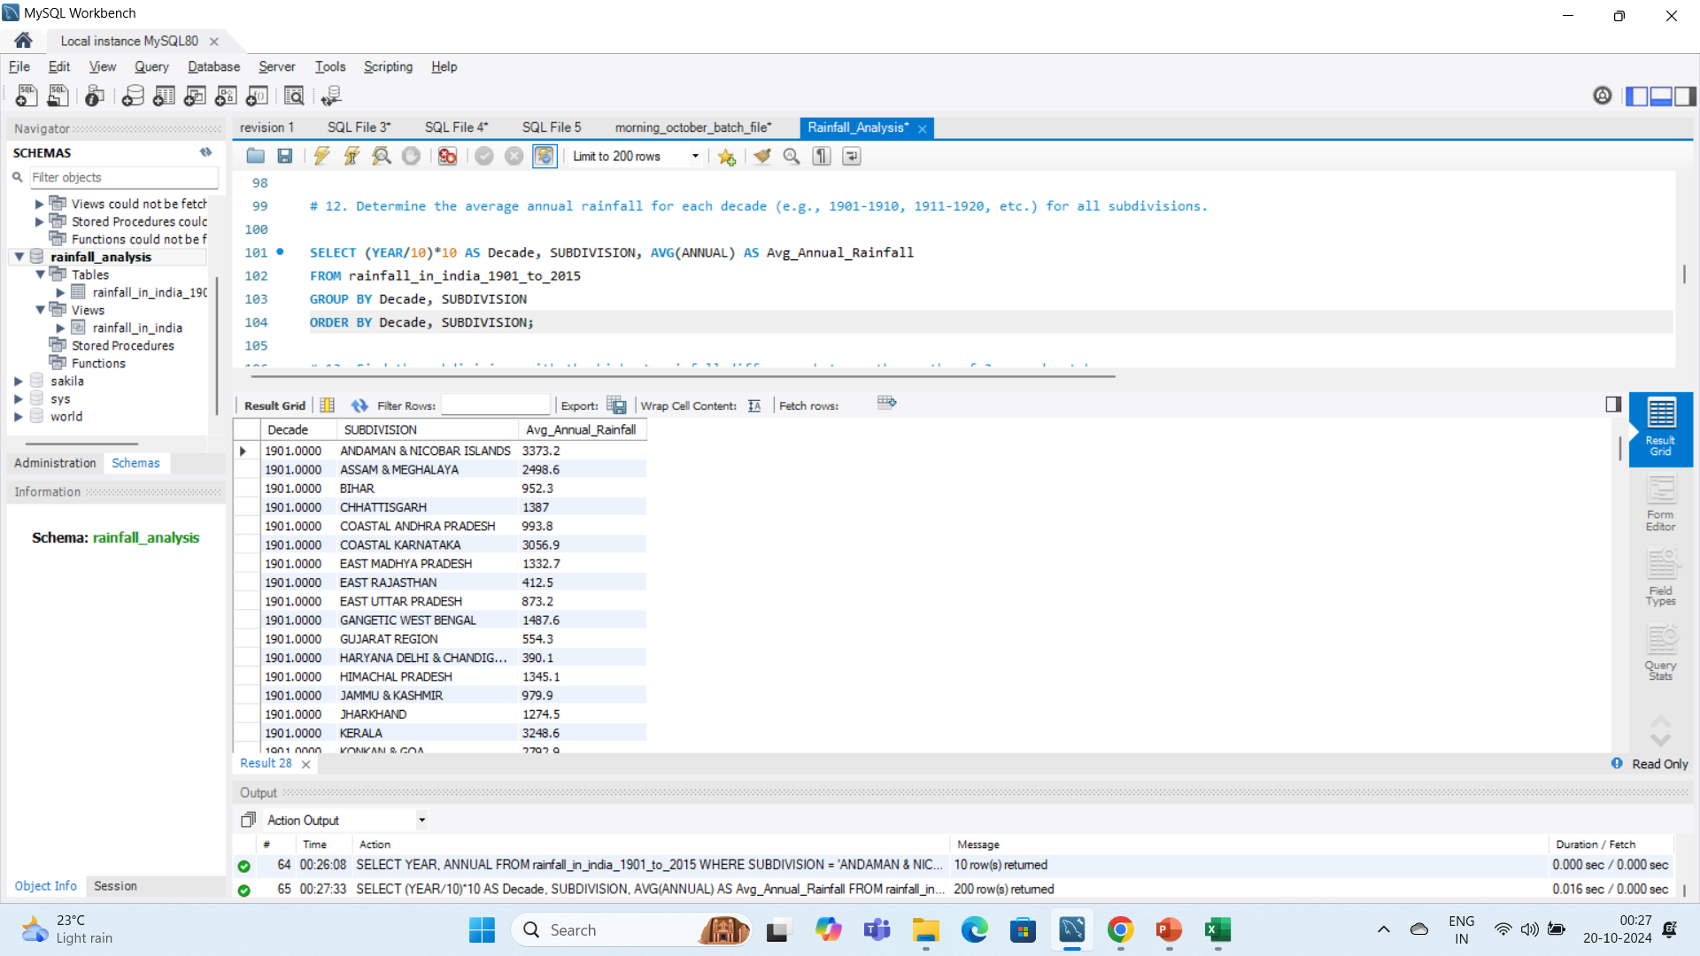
# 12. Determine the average annual rainfall for each decade (e.g., 1901-1910, 1911-1920, etc.) for all subdivisions.

Slide 16
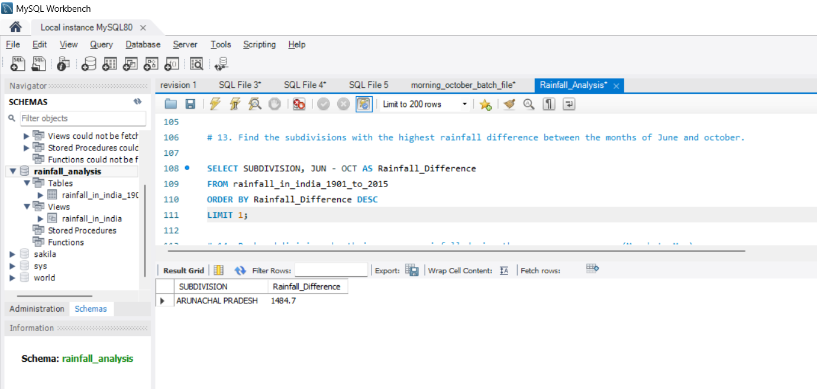
# 13. Find the subdivisions with the highest rainfall difference between the months of June and october.

Slide 17
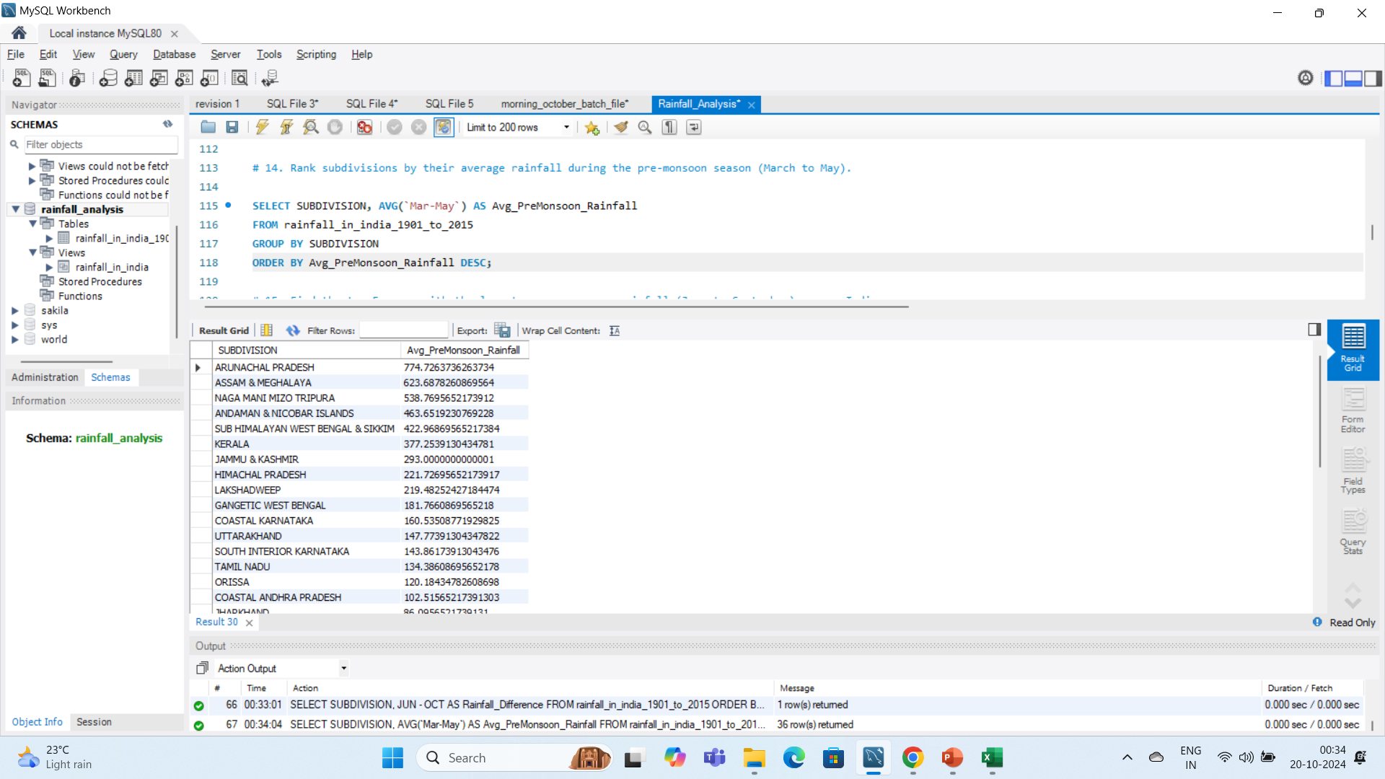
# 14. Rank subdivisions by their average rainfall during the pre-monsoon season (March to May).

Slide 18
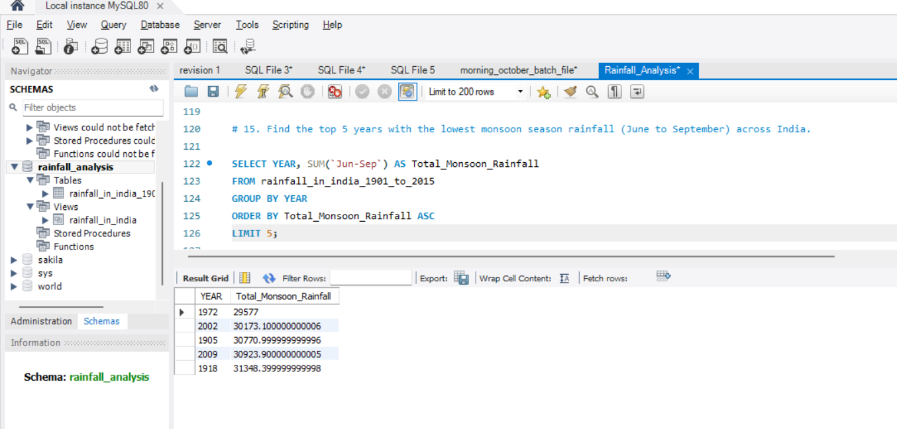
# 15. Find the top 5 years with the lowest monsoon season rainfall (June to September) across India.

Slide 19
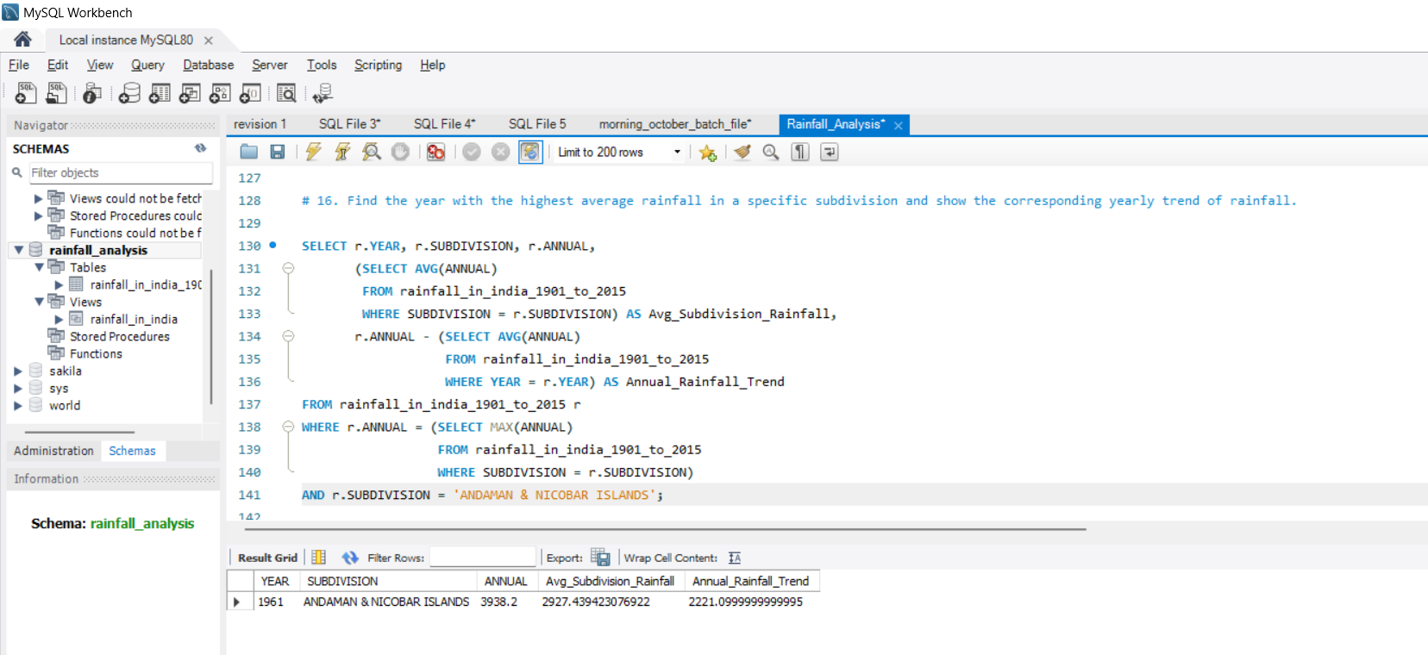
# 16. Find the year with the highest average rainfall in a specific subdivision and show the corresponding yearly trend of rainfall.

Slide 20
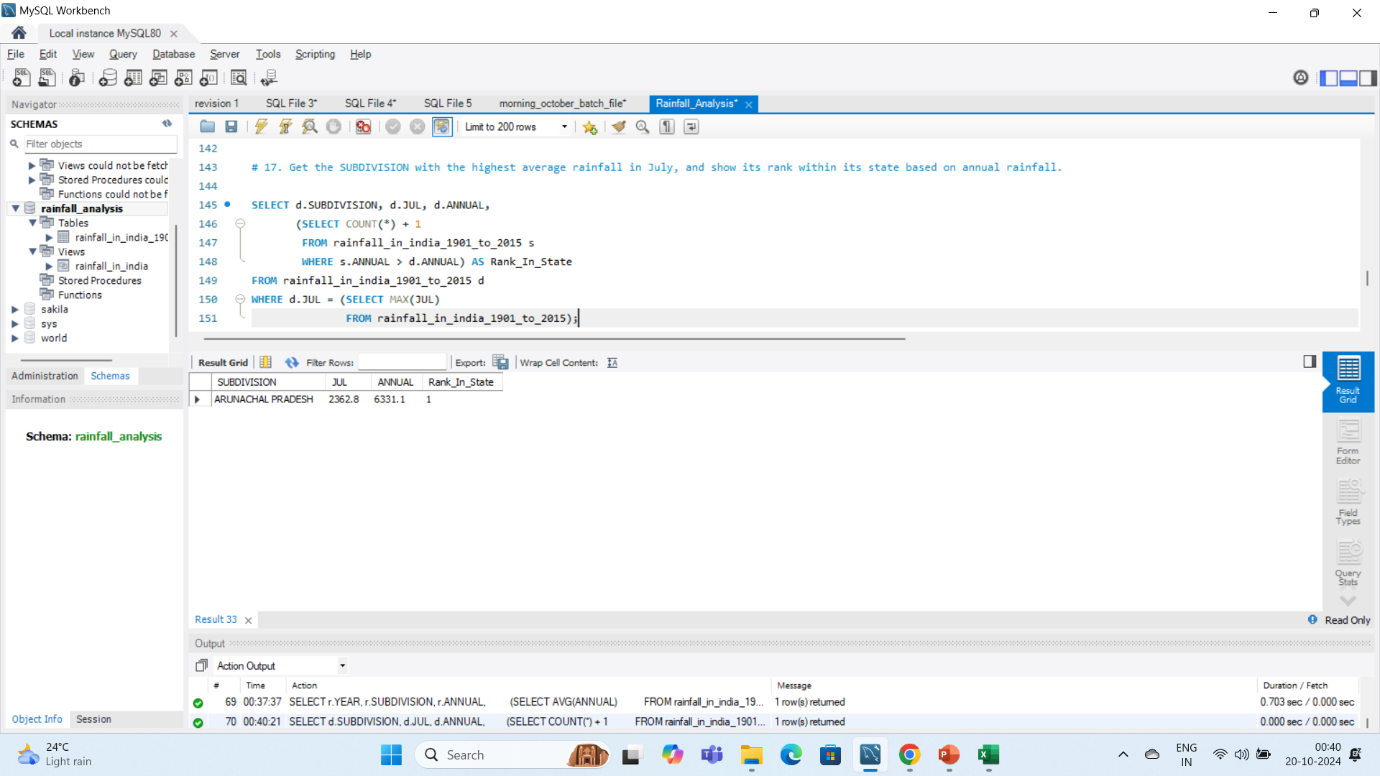
# 17. Get the SUBDIVISION with the highest average rainfall in July, and show its rank within its state based on annual rainfall.

Slide 21
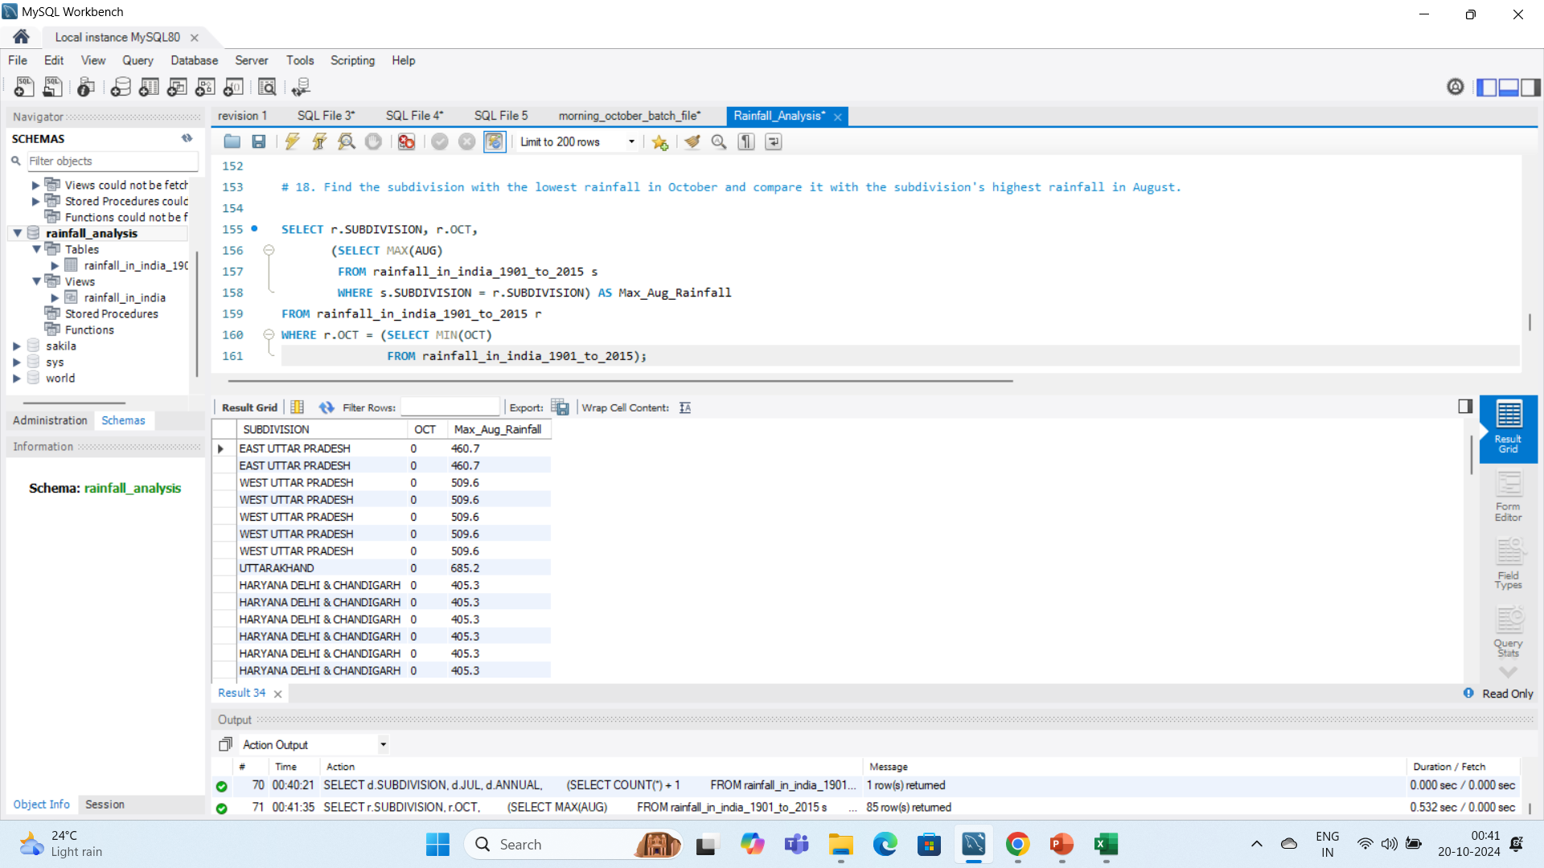
# 18. Find the subdivision with the lowest rainfall in October and compare it with the subdivision's highest rainfall in August.

Slide 22
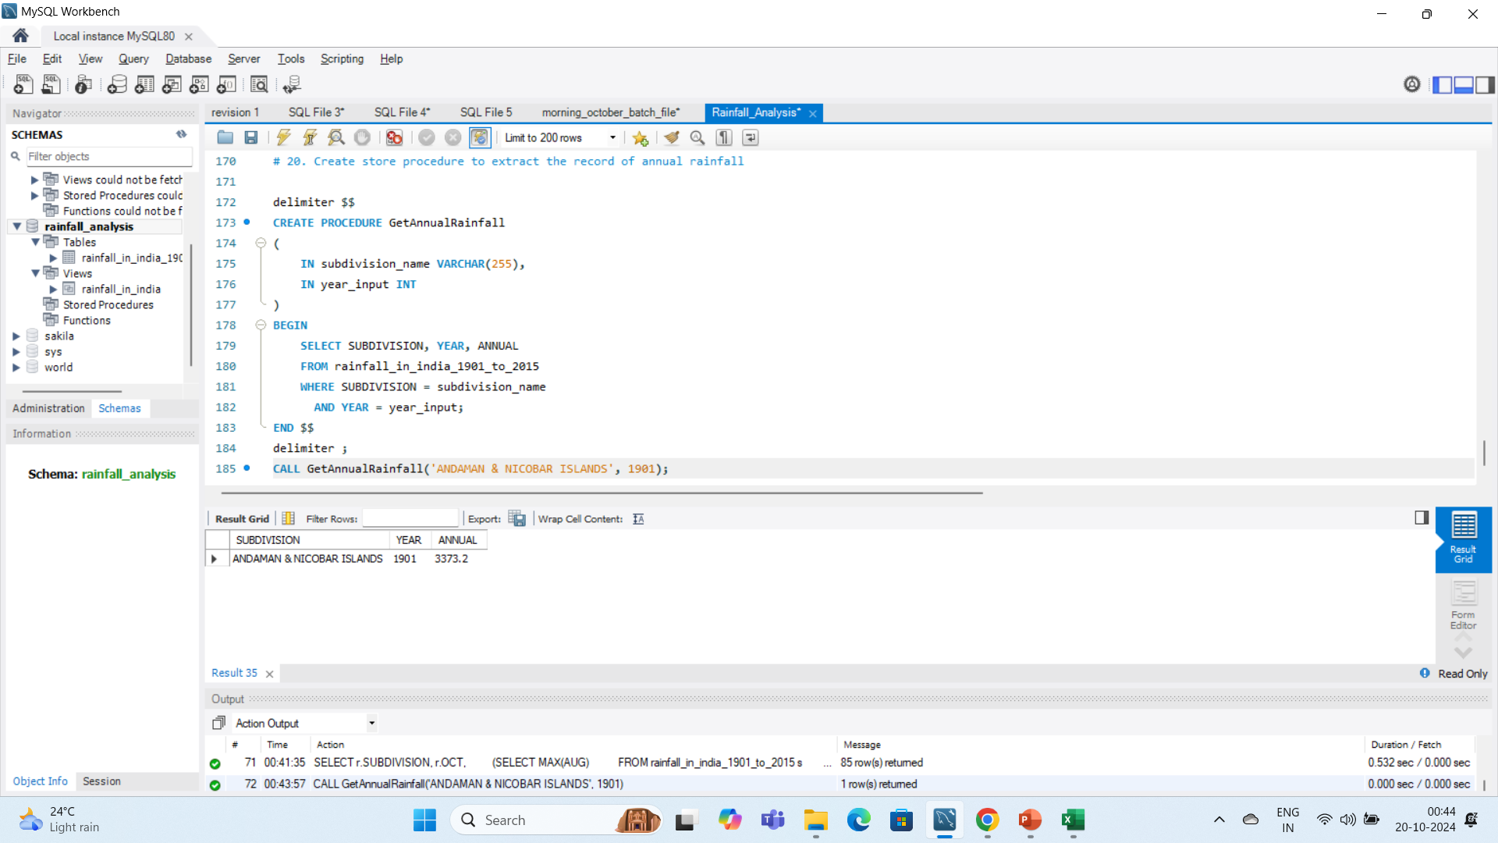
# 20. Create store procedure to extract the record of annual rainfall

Slide 23
CONCLUSION
The analysis provides insights into the rainfall patterns across different regions of India. It helps identify areas with extreme rainfall, such as the subdivision with the highest rainfall in June, which can aid in climate studies and water resource management.

Slide 24
THANK YOU !

